Slide 1

C.A.P.P. Training
Oct. 26, 2025

Slide 2

C.A.P.P. Definition:
Child
Abuse
Prevention
Policy
We are all responsible for making sure that bad things don’t happen to the children of our church, and to know the signs of neglect and abuse.
This Photo by Unknown Author is licensed under CC BY-NC-ND
Notes:
Part 1: Definitions

Slide 3
Neglect
The failure to provide for a Child’s Basic Needs

Slide 4
Types of Neglect:
Physical Neglect:
The failure to provide necessary physical needs such as food and shelter; alternatively, a lack of appropriate supervision.
Medical Neglect
The failure to provide necessary Medical or Mental Health Treatments

Slide 5
Types of Neglect:
Educational Neglect
The failure to educate a child or attend to his/her special educational needs
Emotional Neglect
Inattention to a child’s emotional needs, or the failure to provide psychological care.
Also, allowing the child to use alcohol or other drugs

Slide 6
Abuse
Intentional, cruel or violent harm.

Slide 7
Types of Abuse:
Physical Abuse
Physical injury (Ranging from minor bruises to severe fractures or death) as a result of violent physical contact by any means. Such injuries are considered abuse regardless of whether the caretaker intended to hurt the child.
Sexual Abuse
Any sexually explicit activity by a parent or caretaker done to a child or minor, including fondling, incest, rape, sodomy, indecent exposure and exploitation.
Notes:
Obviously the only foreseeable exception to the last part of physical abuse is if a parent is disciplining their child. Assuming the “discipline” in question is what I would call an Appropriate use of force!

Slide 8
Types of Abuse:
Emotional Abuse
A pattern of behavior that impairs a child’s emotional development or sense of self-worth. This may include criticism, threats, rejection, or withholding love, support, and guidance. Emotional abuse is often difficult to prove. Therefore, Child protective services may not be able to intervene without evidence of harm to the child. Note: Emotional abuse is almost always present when other forms or abuse are identified.

Slide 9

Child Safety Guidelines:
2 Adults (Over 18) with kids at all times
3 Adults (Over 18) at overnight events.
When Meeting in classrooms, the door should preferably remain opened. (Especially if it is a door with no window)
Notes:
Part 2: Child Safety Guidelines
More lenient if there is a window, but for sure opened if no window can be viewed through.

Slide 10

Child Safety Guidelines:
2 or more children to the restroom at a time
Adult should stand in the doorway whenever possible to listen out for trouble

Slide 11

Child Safety Guidelines:
Always Correct dangerous, disruptive, or unusual behavior and report it to the person in charge
Notes:
Should say “Correct dangerous….behavior and report it to the person in charge”

Slide 12

Child Safety Guidelines:
It is always preferred that women change diapers

Slide 13

Child Safety Guidelines:
Off site Approval should always be confirmed with parent or guardian before taking Children off church property
Male and female chaperones for all overnight events
Pick up, drop off, and trip itineraries should always be disclosed to parents, and plan deviations should be minimized

Slide 14

Child Safety Guidelines:
Avoid the appearance of inappropriate behavior.
Notes:
Obviously yelling, arguing, and fighting are a no-no! But this goes for behavior between people of the opposite gender too. See next slide for “Appropriate signs of affection”

Slide 15

Child Safety Guidelines:
Physical contact with opposite sex should always stay G-rated
Always use appropriate expressions of affection: High fives, fist bump, side hug, etc…
Notes:
As mentioned in previous slide, these are appropriate signs of affection

Slide 16

Children’s Worker Guidelines:
Emergency Response:
Render whatever aid you can on the spot
Remove them from immediate harm
Unless you are trained in first aid, it is best not to move the victim
Keep calm
Dial 9-1-1 if needed
Notes:
Part 2.5 Child worker Guidelines

Slide 17
Children’s Worker Guidelines:
All injuries or suspected abuse should be reported to the Department Leader who will report to the Chair of Deacons and Pastor.

Slide 18
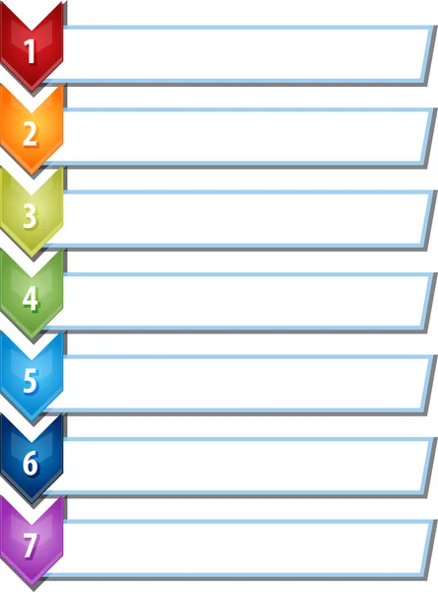
Reporting Abuse
Insure Child’s safety
Report the event
Abuse is a complex issue. Abuse trends are showing an increase of children abusing children and an increase in women offenders. Therefore, a broad understanding of violators and victims is required.
All abuse or suspected abuse must be reported to the department head or staff in charge.
Make appropriate notes
Do not discuss the event
Do not confront individual
Remove individual
Church Staff take over
Notes:
Part 3: Reporting Abuse (7 steps)
No source connected to that first statement, but I believe it’s intent is to remind people that abuse can be perpetrated by anyone of any age or gender.

Slide 19
Reporting Abuse
STEP
1
Immediately ensure the safety of the child or youth.

Slide 20
Reporting Abuse
STEP
2
Report the event immediately to the department head or staff person in charge.
(DO NOT leave the child alone while doing so)

Slide 21
Reporting Abuse
STEP
3
Make notes as appropriate as to what was seen or heard.

Slide 22
Reporting Abuse
STEP
4
DO NOT discuss the event with anyone other than the senior pastor, department head, or relevant church staff member.
Notes:
This is to protect the victim’s personal rights and privacy! It is not to try to protect the church or the perpetrator from prosecution.

Slide 23
Reporting Abuse
STEP
5
DO NOT confront the alleged perpetrator

Slide 24
Reporting Abuse
STEP
6
Any employee or volunteer accused will be removed immediately from contact with children until an investigation by authorities is concluded.

Slide 25
Reporting Abuse
STEP
7
The designated church staff member will:
Notify the child’s parent or guardian
Complete incident report
Contact the appropriate authorities
Notify the church’s insurance carrier
Notify the church’s legal counsel, who will determine the appropriate communication necessary to the church and media.
Notes:
Remind them of step 4, where you speak to nobody about the incident. This is to protect the victim’s personal rights and privacy!

Slide 26

Forms
Incident reports
If any incident or emergency occurs, an incident report will be filed by the department leader.
Witness testimony/input may be required in order to complete this form. Be prepared to answer any necessary questions.
Notes:
Part 4: Misc.

Slide 27
Forms
Child Info. Forms
There is a standard form for all children and youth with important info such as emergency contact info, allergies, etc. in the office.
For now, our current churchtrac and permission slip forms are filling this need.

Slide 28

Policy Violations
Persons found to be violating C.A.P.P. will be asked to step down and an investigation will be conducted.

Slide 29

Thank YOU for keeping our children safe!

